Slide 1





Centralized Application Logging and Monitoring for Offsite Environments
Enterprise observability for DCP, GCP, and legacy appsCentralize telemetry, ensure compliance-ready controls, and enable early anomaly detection for Wholesale Credit and Lending offsite teams.
Skandan
AI/ML Engineer

Slide 2






Strategic Objectives for Observability
Five outcomes to secure centralized, compliant, and offsite-ready logging
01
Centralized visibility
02
Early anomaly detection
03
Risk and audit compliance
All app, API, DB, integration, and infra logs converge to one observability pane
Combine metrics, logs, traces, and ML-assisted detection for fast alerts
Enforce immutability, retention, access controls, and masking for audits
04
Standardization across environments
05
Offsite readiness
Align logging format, error taxonomy, KPIs, and alerting standards
Enable remote access, disaster recovery replication, and secure failover

Slide 3

Architecture Blueprint: Logging
Standard JSON schema, environment transports, and storage tiers for secure ingestion and analytics
Storage and Analytics
SIEM, log analytics (BigQuery or equivalent), hot and cold tiers, offsite archive to S3/GCS/secure blob for retention and analytics.
Application Logging Layer
Transport Layer
Standardized JSON schema: timestamp, correlation_id, span_id, customer_or_nonPII_id, request_id, service_name, component, severity, error_code, response_time_ms, payload_hash.
Environment-specific ingestion pipelines to SIEM using agents and routers for reliable delivery and filtering.

Slide 4
Monitoring and Tracing Architecture Blueprint
OpenTelemetry-first telemetry, correlation ID propagation, hot metrics for alerts
01
02
03
04
05
Instrumentation
Collector and Sidecar
Storage: Metrics and Traces
Dashboards and Alerts
SLO/SLA Consistency
Instrument apps with OpenTelemetry; propagate correlation_id and span_id for cross-system correlation
Deploy OTEL collectors or sidecars to normalize and enrich telemetry before central ingestion
Normalized telemetry enables consistent SLO/SLA measurement and efficient troubleshooting across environments
Send metrics to Prometheus, Stackdriver, Dynatrace, or Datadog; send traces to Jaeger, OpenTelemetry Collector, or Dynatrace
Build dashboards in Grafana, Looker, or Datadog; configure hot metrics for alerting and cold storage for audits

Slide 5







Standards and Governance for Logging and Monitoring
Enforce consistent logs, SLIs/SLOs, and audit-ready controls
Governance Actions
Retention policies aligned to regulations
Role based access control for log access
Monitoring Standards and KPIs
Maintain audit trails for access and changes
SLIs/SLOs: Availability 99.9%
Ensure controls work across DCP, GCP, and on prem
Logging Standards
Latency target: P95 less than 200ms
Error rate target: less than 0.1%
Use JSON log format and mandatory correlation IDs
Define throughput targets per product
Apply common error taxonomy e.g., AUTH-1000, DB-3000, API-4000
Prohibit PII; require tokenization or masking via regex and KMS

Slide 6


Logging flow (DCP)
Monitoring flow (DCP)
1.
Containerized and legacy workloads use platform logging hooks
1.
Use DCP-native host and container monitoring plus OpenTelemetry for app metrics and traces
DCP Observability: Logging vs Monitoring
2.
Deploy FluentBit or OpenTelemetry collector sidecars for standardization
2.
Aggregate metrics and traces into centralized Grafana or Dynatrace
3.
Sidecars forward logs to central Kafka, Splunk or Elastic, and S3 for retention
3.
Combine host, container, and OTEL signals for full-stack visibility
Side-by-side flow comparison with enforceable controls
4.
Ensure platform policy enforces consistent sidecar deployment
4.
Enforce RBAC for observability access

Slide 7
Sources
BigQuery
GKE, Cloud Run, App Engine, Compute Engine logs and metrics
Batch and interactive analytics for large datasets
Cloud Storage
Cloud Logging
Cold retention archive with lifecycle policies
Ingest and normalize application and system logs
GCP Logging and Monitoring Pipeline
Log Router
Filter and route logs to downstream systems
Centralize logs, route to SIEM, analytics, and cold archive
Pub/Sub
Durable transport for streaming delivery to consumers
SIEM (Splunk/Elastic)
Real-time security and operational analytics

Slide 8
Log collection agents
Use Prometheus Node Exporter for host and infra metrics collection and alerting
Deploy syslog, Fluentd, or Filebeat to collect file-based logs and add JSON correlation IDs
Application telemetry
Secure VPN tunnels
Deploy OTEL agents for application metrics and distributed traces
Forward logs securely over VPN with encrypted, authenticated channels to central systems
Batch job observability
Legacy Logging and Monitoring Strategy
Forward legacy batch events to an event bridge or message queue for observability
Central SIEM ingestion
Ingest normalized JSON logs with correlation IDs into SIEM for detection and analysis
Phased migration of file logs to centralized SIEM and observability
Phased migration
Normalize formats, validate pipelines, and migrate in phases to minimize disruption
Archival to S3
Store compressed logs in S3 for retention, compliance, and forensic access
Infrastructure monitoring

Slide 9






Observability Controls for SRE, Risk, and Audit
Immutable logs, strong encryption, zero-trust access, and DR visibility
01
Immutability: immutable logs with retention that supports audit evidence
02
Encryption: TLS 1.2 or higher in transit and KMS-backed encryption at rest
03
Access Control: zero-trust access and RBAC with 90-day access reviews
WORM-style logging and tamper-evident storage
Ensure keys are managed and auditable
Least privilege plus periodic entitlement reviews
04
DR and Offsite: replicate logs to offsite regions and maintain offsite monitoring
05
Anomaly Detection: integrate ML tools with incident workflows
06
Operational Evidence: map controls to audit evidence and SRE runbooks
Detect spikes in loan rejects, unusual latency, auth anomalies, abnormal API traffic
Provide DR failover dashboards and continuous offsite monitoring
Runbooks linked to monitoring alerts and evidence artifacts

Slide 10
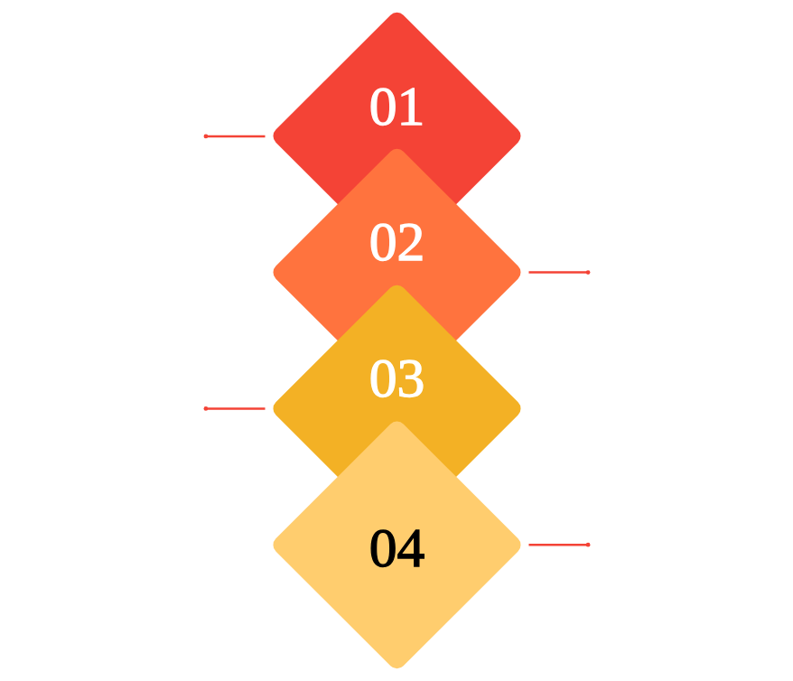
Offsite Consumption Strategy for Telemetry
Secure remote access, centralized observability, defined operating model
Offsite Access Layer
VPN or ZTNA with MFA and identity federation for secure remote access.
Centralized Observability Platform
Cloud SaaS stack for logs, metrics, traces, incidents, and dashboards.
Operating Model
L1 offsite, L2 hybrid, L3 development with clear escalation and runbooks.
Compliance Controls
Access logging, anomaly detection, least privilege, restrict raw downloads.

